Slide 1
1
Unit III Data Warehouse

Slide 2

Unit III Data Warehouse Business Intelligence and Data Analytics
Mrs. Madhuri Prashant Karnik
madhuri.chavan@viit.ac.in
Department of Computer Engineering
BRACT’S, Vishwakarma Institute of Information Technology, Pune-48
(An Autonomous Institute affiliated to Savitribai Phule Pune University)
(NBA and NAAC accredited, ISO 9001:2015 certified)

Slide 3
3
Topics
Introduction
Data Warehouse Modeling: Data Cube and OLAP Data Warehouse Design and Usage
Distributed Data-warehouse and materialized view
Different types of OLAP and their applications
Difference between OLAP and OLTP
Big Data Lakes
Department of Computer Engineering, VIIT , Pune-48

Slide 4
4
Data warehouse
A data warehouse is a repository (or archive) of information gathered from multiple sources, stored under a unified schema, at a single site.
Once gathered, the data are stored for a long time.
Thus, data warehouses provide the user a single combined interface to data, making decision-support queries easier to write.
Department of Computer Engineering, VIIT , Pune-48

Slide 5
5
What is Data Warehouse?
“A data warehouse is a subject-oriented, integrated, time-variant, and nonvolatile collection of data in support of management’s decision-making process.”—W. H. Inmon (father of data warehousing).
A data warehouse is simply a single, complete, and consistent store of data obtained from a variety of sources and made available to end users in a way they can understand and use it in a business context
Data warehousing:
The process of constructing and using data warehouses.
Department of Computer Engineering, VIIT , Pune-48
Notes:
5

Slide 6
6
Data Warehouse—Subject-Oriented
The Data warehouse is subject oriented because it provide us the information around a subject rather the organization's ongoing operations.
These subjects can be product, customers, suppliers, sales etc.
The data warehouse does not focus on the ongoing operations rather it focuses on modeling and analysis of data for decision making.
Provide a simple and concise/brief view around particular subject issues by excluding data that are not useful in the decision support process.
Department of Computer Engineering, VIIT , Pune-48

Slide 7
7
Data Warehouse—Integrated
Data Warehouse is constructed by integration of data from heterogeneous sources such as relational databases, on-line transaction records etc.
This integration enhance the effective analysis of data.
Data cleaning and data integration techniques are applied.
Ensure consistency in naming conventions, encoding structures, attribute measures, etc. among different data sources
When data is moved to the warehouse, it is converted.
Department of Computer Engineering, VIIT , Pune-48

Slide 8
8
Data Warehouse—Time Variant
The Data in Data Warehouse is identified with a particular time period. The data in data warehouse provide information from historical point of view.
The time horizon /scope for the data warehouse is significantly longer than that of operational systems
Operational database: current value data
Data warehouse data: provide information from a historical perspective (e.g., past 5-10 years)
Every key structure in the data warehouse
Contains an element of time
But the key of operational data may or may not contain “time element”
Department of Computer Engineering, VIIT , Pune-48

Slide 9
9
Data Warehouse—Nonvolatile
Non volatile means that the previous data is not removed when new data is added to it.
The data warehouse is kept separate from the operational database therefore frequent changes in operational database is not reflected in data warehouse, that is a physically separate store of data transformed from the operational environment.
Operational update of data does not occur in the data warehouse environment
Does not require transaction processing, recovery, and concurrency control mechanisms
Data warehouse is read only.
Requires only two operations in data accessing:
initial loading of data and access of data
Department of Computer Engineering, VIIT , Pune-48

Slide 10
10
Data Warehouse—Metadata
Metadata is simply defined as data about data.
The data that are used to represent other data is known as metadata.
For example the index of a book serve as metadata for the contents in the book.
It means the metadata is the summarized data that lead us to the detailed data.
Department of Computer Engineering, VIIT , Pune-48

Slide 11
11
Operational Data
It is used to run the buisness.
This data is typically stored,retrived and updated by OLTP(Online Transaction Processing) system.
Example of OLTP: a reservation system, an accounting application, or an order-entry application.
Department of Computer Engineering, VIIT , Pune-48

Slide 12
12
Informational Data
It is created from operational data.
Informational data is typically
-summarized operational data.
-Denormalized and replicated data.
-possibly read only
-Stored on separate systems etc.
Department of Computer Engineering, VIIT , Pune-48

Slide 13
13
Why Data Warehouse Separated from Operational Databases?
The operational database is constructed for well known tasks and workload such as searching particular records, indexing etc but the data warehouse queries are often complex and it presents the general form of data.
Operational databases supports the concurrent processing of multiple transactions. Concurrency control and recovery mechanism are required for operational databases to ensure robustness and consistency of database.
Operational database query allow to read, modify operations while the OLAP query need only read only access of stored data.
Operational database maintain the current data on the other hand data warehouse maintain the historical data.
Department of Computer Engineering, VIIT , Pune-48

Slide 14
14
Why Separate Data Warehouse?
DBMS— tuned for OLTP: access methods, indexing, concurrency control, recovery.
Warehouse—tuned for OLAP: complex OLAP queries, multidimensional view, consolidation.
Different functions and different data:
missing data: Decision support requires historical data which operational DBs do not typically maintain
data consolidation: DBs requires consolidation (aggregation, summarization) of data from heterogeneous sources
data quality: different sources typically use inconsistent data representations, codes and formats which have to be reconcile
Department of Computer Engineering, VIIT , Pune-48

Slide 15
Data Warehouse: A Multi-Tiered Architecture
Monitor
&
Integrator
OLAP Server
Other
sources
Metadata
Analysis
Query/
Reports
Data mining
Operational
DBs
Extract
Transform
Load
Refresh
Data
Warehouse
Serve
Data Marts
Data Sources
Data Storage
OLAP Engine
Front-End Tools
Department of Computer Engineering, VIIT , Pune-48

Slide 16
16
Data Warehouse Back-End Tools and Utilities
Data extraction
get data from multiple, heterogeneous, and external sources
Data cleaning
detect errors in the data and rectify them when possible
Data transformation
convert data from host format to warehouse format
Load
sort, summarize, consolidate, compute views, check integrity, build and partitions
Refresh
propagate (transmit) the updates from the data sources to the warehouse
Department of Computer Engineering, VIIT , Pune-48

Slide 17
17
Three-Tier Architecture
Warehouse database server
Almost always a relational DBMS, unstructured data.
OLAP servers
Relational OLAP (ROLAP): extended relational DBMS that maps operations on multidimensional data to standard relational operations.
Multidimensional OLAP (MOLAP): special purpose server that directly implements multidimensional data and operations.
Clients
Query and reporting tools
Analysis tools
Data mining tools (e.g., trend analysis, prediction)
Department of Computer Engineering, VIIT , Pune-48
Notes:
17

Slide 18
18
Three Data Warehouse Models
Enterprise warehouse
It contains detailed data as well as summarized data.
The enterprise warehouse collects all the information all the subjects spanning the entire organization
This provide us the enterprise-wide data integration.
The data is integrated from operational systems and external information providers.
This information can vary from a few gigabytes to hundreds of gigabytes, terabytes or beyond.
Department of Computer Engineering, VIIT , Pune-48

Slide 19
19
Data Mart
a subset of corporate-wide data that is of value to a specific groups of users.
in other words we can say that data mart contains only that data which is specific to a particular group.
Its scope is confined to specific, selected groups, such as marketing data mart
For example the marketing data mart may contain only data related to item, customers and sales.
Department of Computer Engineering, VIIT , Pune-48

Slide 20
20
Virtual warehouse
A set of views over operational databases
Only some of the possible summary views may be materialized.
The view over a operational data warehouse is known as virtual warehouse.
Building the virtual warehouse requires excess capacity on operational database servers.
Department of Computer Engineering, VIIT , Pune-48

Slide 21
21
Data Warehouse Usage
Three kinds of data warehouse applications
Information processing
supports querying, basic statistical analysis, tables, charts and graphs
Analytical processing
multidimensional analysis of data warehouse data
supports basic OLAP operations, slice-dice, drilling, pivoting
Data mining
knowledge discovery from hidden patterns
supports associations, constructing analytical models, performing classification and prediction, and presenting the mining results using visualization tools
Department of Computer Engineering, VIIT , Pune-48

Slide 22
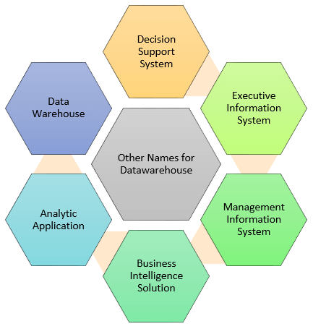
Other Names of Data Warehouse

Slide 23
DWH Examples
Airline:
In the Airline system, it is used for operation purpose like crew
assignment, analyses of route profitability, frequent flyer program
promotions, etc.
Banking:
It is widely used in the banking sector to manage the resources
available on desk effectively. Few banks also used for the market
research, performance analysis of the product and operations.
Healthcare:
Healthcare sector also used Data warehouse to strategize and
predict outcomes, generate patient's treatment reports,
share data with tie-in insurance companies, medical aid services, etc.

Slide 24
Applications
Public sector:
In the public sector, data warehouse is used for intelligence gathering.
It helps government agencies to maintain and analyze tax records, health policy records,
for every individual.
Investment and Insurance sector:
In this sector, the warehouses are primarily used to analyze data patterns,
customer trends, and to track market movements.
Retain chain:
In retail chains, Data warehouse is widely used for distribution and marketing.
It also helps to track items, customer buying pattern, promotions and also used for
determining pricing policy.
Telecommunication:
A data warehouse is used in this sector for product promotions, sales decisions
and to make distribution decisions.

Slide 25
Sr.No | Tasks | Deliverables
1 | Need to define project scope | Scope Definition
2 | Need to determine business needs | Logical Data Model
3 | Define Operational Datastore requirements | Operational Data Store Model
4 | Acquire or develop Extraction tools | Extract tools and Software
5 | Define Data Warehouse Data requirements | Transition Data Model
6 | Document missing data | To Do Project List
7 | Maps Operational Data Store to Data Warehouse | D/W Data Integration Map
8 | Develop Data Warehouse Database design | D/W Database Design
9 | Extract Data from Operational Data Store | Integrated D/W Data Extracts
10 | Load Data Warehouse | Initial Data Load
11 | Maintain Data Warehouse | On-going Data Access and Subsequent Loads

Slide 26
DWH tools
Cdata Sync
Query Surge
Xplentry
Oracle
Amazon redshift
Panoply
SAP/SAS
Tabaleu
Pentaho

Slide 27
27
Data Warehouse Schemas
Data warehouses typically have schemas that are designed for data analysis, using tools such as OLAP tools.
Thus, the data are usually multidimensional data, with dimension attributes and measure attributes.
Tables containing multidimensional data are called fact tables and are usually very large.
A table recording sales information for a retail store, with one tuple for each item that is sold, is a typical example of a fact table.
Department of Computer Engineering, VIIT , Pune-48

Slide 28
28
The dimensions of the sales table would include what the item is (usually an item identifier such as that used in bar codes), the date when the item is sold, which location (store) the item was sold from, which customer bought the item, and so on. The measure attributes may include the number of items sold and the price of the items.
To minimize storage requirements, dimension attributes are usually short identifiers that are foreign keys into other tables called dimension tables.
Department of Computer Engineering, VIIT , Pune-48

Slide 29
29
For instance, a fact table sales would have attributes item id, store id, customer id, and date, and measure attributes number and price.
The attribute store id is a foreign key into a dimension table store, which has other attributes such as store location (city, state, country).
The item id attribute of the sales table would be a foreign key into a dimension table item info, which would contain information such as the name of the item, the category to which the item belongs, and other item details such as color and size.
Department of Computer Engineering, VIIT , Pune-48

Slide 30
30
The customer id attribute would be a foreign key into a customer table containing attributes such as name and address of the customer.
Similarly the date attribute as a foreign key into a date info table giving the month, quarter, and year of each date.
Department of Computer Engineering, VIIT , Pune-48

Slide 31
31
Example of Star Schema
time
time_key
day
day_of_the_week
month
quarter
year
item
item_key
item_name
brand
type
supplier_type
Sales Fact Table
time_key
item_key
branch_key
branch
location
location_key
branch_key
branch_name
branch_type
location_key
street
city
state_or_province
country
units_sold
dollars_sold
avg_sales
Measures
Department of Computer Engineering, VIIT , Pune-48

Slide 32
32
Such a schema, with a fact table, multiple dimension tables, and foreign keys from the fact table to the dimension tables, is called a star schema.
More complex data-warehouse designs may have multiple levels of dimension tables;
For example, the item info table may have an attribute manufacturer id that is a foreign key into another table giving details of the manufacturer.
Such schemas are called snowflake schemas.
Complex data warehouse designs may also have more than one fact table.
Department of Computer Engineering, VIIT , Pune-48

Slide 33
33
Example of Snowflake Schema
time
item
time_key
day
day_of_the_week
month
quarter
year
item_key
item_name
brand
type
supplier_key
supplier
Sales Fact Table
supplier_key
supplier_type
time_key
item_key
branch_key
branch
location
location_key
location_key
street
city_key
branch_key
branch_name
branch_type
units_sold
dollars_sold
city
city_key
city
state_or_province
country
avg_sales
Measures
Department of Computer Engineering, VIIT , Pune-48

Slide 34
34
Fact Constellation
Multiple fact tables share dimension tables, viewed as a collection of stars, therefore called galaxy schema or fact constellation
Department of Computer Engineering, VIIT , Pune-48

Slide 35
35
Example of Fact Constellation
time
time_key
day
day_of_the_week
month
quarter
year
item
Shipping Fact Table
item_key
item_name
brand
type
supplier_type
Sales Fact Table
time_key
time_key
item_key
shipper_key
item_key
branch_key
from_location
branch
location_key
location
to_location
branch_key
branch_name
branch_type
units_sold
location_key
street
city
province_or_street
country
dollars_cost
dollars_sold
units_shipped
shipper
Measures
shipper_key
shipper_name
location_key
shipper_type

Slide 36
Can u design a schema for Academic schedule and the classroom/Laboratory
utilization of a college
Average class room utilization
Average class room utilization per semester
Maximum utilization per semester
Minimum utilization of a class room per semester
Minimum utilization of a class room per branch
Minimum utilization of a class room per class(FY to Mtech)
Average availability in hours of a seminar hall
Average availability in morning slot(1st quartile) of a seminar hall
Average availability during lunch break of a seminar hall etc
2 dimensional relation table :
class room and time, ( derived attribute : total utilization of classrooms,
Weekly utilization,monthly yearly utilization)
2. class room and year (total class rooms allotted to FY/SY/TY and so on, max
Class rooms allotted to which year etc)
3. class room and branch

Slide 37
Managerial decision
Based on utilization, can we club classrooms of different courses
Can we run parellely different academic programs in an educational Institute
Which department can run in one shift only
Which subject requires more Theory sessions etc
Three dimensional view :
class room, time, Branch
class room, time ,year
class room, time, subject
What are the derived attributes ????

Slide 38
38
Conceptual Modeling of Data Warehouses
Modeling data warehouses: dimensions & measures
Star schema: A fact table in the middle connected to a set of dimension tables
Snowflake schema: A refinement of star schema where some dimensional hierarchy is normalized into a set of smaller dimension tables.
Fact constellations: Multiple fact tables share dimension tables, viewed as a collection of stars, therefore called galaxy schema or fact constellation
Department of Computer Engineering, VIIT , Pune-48
Notes:
38

Slide 39
39
Multidimensional Data Model
Database is a set of facts (points) in a multidimensional space.
A fact has a measure dimension
quantity that is analyzed, e.g., sale, budget
A set of dimensions on which data is analyzed
e.g. , store, product, date associated with a sale amount
Each dimension has a set of attributes
e.g., owner city and region of store
Attributes of a dimension may be related by partial order
Hierarchy: e.g., street > region >city
Lattice/pattern: e.g., date> month>year, date>week>year
Department of Computer Engineering, VIIT , Pune-48
Notes:
39

Slide 40
Multidimensional Data
Date
Total annual sales
of TV in U.S.A.
1Qtr
2Qtr
3Qtr
4Qtr
sum
Product
TV
PC
U.S.A
VCR
sum
Canada
Country
Mexico
sum
All, All, All
Department of Computer Engineering, VIIT , Pune-48

Slide 41
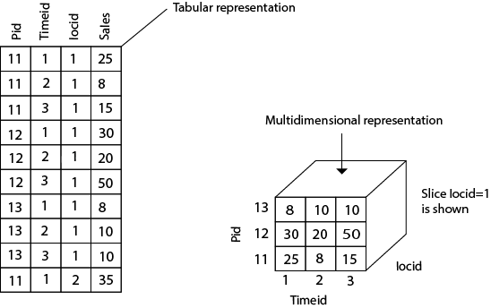
Example

Slide 42
42
OLAP
OLAP technology is a vast improvement over traditional relational database management systems (RDBMS).
Relational databases, which have a two-dimensional structure, do not allow the multidimensional data views that OLAP provides.
Traditionally used as an analytical tool for marketing and financial reporting, OLAP is viewed as a valuable tool for any management system that needs to create a flexible decision support system.
Department of Computer Engineering, VIIT , Pune-48

Slide 43
43
Traditional tools of report writers, query products, spreadsheets, & language interfaces do not match the user expectations as far as performing multidimensional analysis with complex calculations is concerned.
Tools used with OLTP and basic DW environments do not match up to the task.
OLAP provides the multidimensional capabilities that most organizations need today.
Department of Computer Engineering, VIIT , Pune-48

Slide 44
44
OLAP
OLAP is a category of software technology that enables analysts, managers, and executives to gain insight into the data through fast, consistent, interactive, access in a wide variety of possible views of information that has been transformed from raw data to reflect the real dimensionality of the enterprise as understood by the user.
Department of Computer Engineering, VIIT , Pune-48

Slide 45
45
What and Why OLAP?
OLAP is the dynamic synthesis, analysis, and consolidation of large volumes of multi-dimensional data.
OLAP is the term that describes a technology that uses multi-dimensional view of aggregate data to provide quick access to strategic information for the purposes of advanced analysis.
OLAP enables users to gain a deeper understanding and knowledge about various aspects of their corporate data through fast, consistent, interactive access to a variety of possible views of data.
Department of Computer Engineering, VIIT , Pune-48

Slide 46
46
OLAP Applications
Finance: Budgeting, activity-based costing, financial performance analysis, and financial modeling.
Sales: Sales analysis and sales forecasting.
Marketing: Market research analysis, sales forecasting, promotions analysis, customer analysis, and market/customer segmentation.
Manufacturing: Production planning and defect analysis.
Department of Computer Engineering, VIIT , Pune-48

Slide 47
47
OLAP Key Features
Multi-dimensional views of data.
Support for complex calculations.
Time Intelligence.
Department of Computer Engineering, VIIT , Pune-48

Slide 48
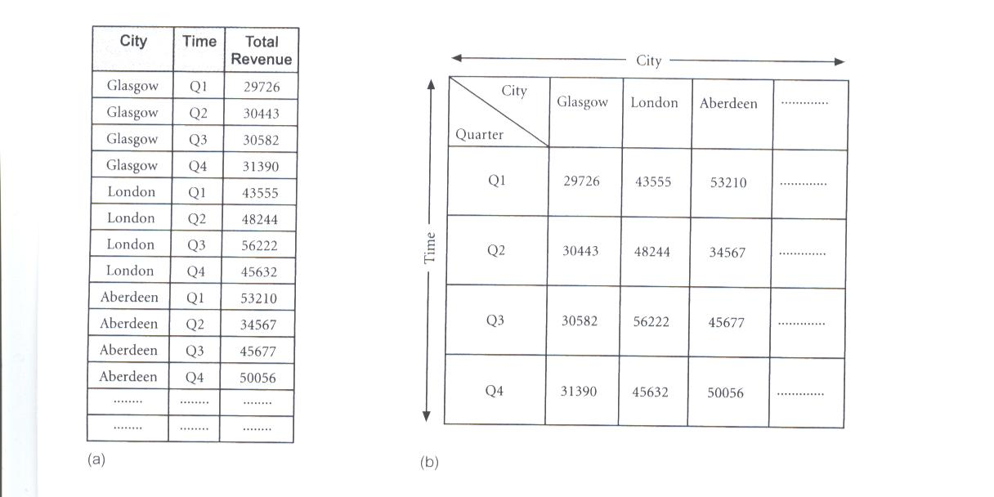
48
Representation of Multi-Dimensional Data
OLAP database servers use multi-dimensional structures to store data and relationships between data.
Multi-dimensional structures are best-visualized as cubes of data, and cubes within cubes of data. Each side of a cube is a dimension.
Department of Computer Engineering, VIIT , Pune-48

Slide 49
49
Representation of Multi-Dimensional Data
Multi-dimensional databases are a compact and easy-to-understand way of visualizing and manipulating data elements that have many inter-relationships.
The cube can be expanded to include another dimension, for example, the number of sales staff in each city.
The response time of a multi-dimensional query depends on how many cells have to be added on-the-fly.
As the number of dimensions increases, the number of cube’s cells increases exponentially.
Department of Computer Engineering, VIIT , Pune-48

Slide 50
50
From Tables and Spreadsheets to Data Cubes
A data warehouse is based on a multidimensional data model which views data in the form of a data cube
A data cube, such as sales, allows data to be modeled and viewed in multiple dimensions
Dimension tables, such as item (item_name, brand, type), or time(day, week, month, quarter, year)
Fact table contains measures (such as dollars_sold) and keys to each of the related dimension tables
An n-D base cube is called a base cuboid. The top most 0-D cuboid, which holds the highest-level of summarization, is called the apex cuboid. The lattice of cuboids forms a data cube.
Department of Computer Engineering, VIIT , Pune-48
Notes:
50

Slide 51
51
Cuboids Corresponding to the Cube
all
0-D(apex) cuboid
product
date
country
1-D cuboids
product,date
product,country
date, country
2-D cuboids
3-D(base) cuboid
product, date, country
Department of Computer Engineering, VIIT , Pune-48

Slide 52
52
Lattice of Cuboids
all
0-D(apex) cuboid
time
item
location
supplier
1-D cuboids
time,item
time,location
item,location
location,supplier
2-D cuboids
time,supplier
item,supplier
time,item,location
time,location,supplier
3-D cuboids
time,item,supplier
item,location,supplier
4-D(base) cuboid
time, item, location, supplier
Department of Computer Engineering, VIIT , Pune-48

Slide 53
53
OLAP Tools - Categories
OLAP tools are categorized according to the architecture used to store and process multi-dimensional data.
There are four main categories of OLAP tools as defined by Berson and Smith (1997) and Pends and Greeth (2001) including:
Multi-dimensional OLAP (MOLAP)
Relational OLAP (ROLAP)
Hybrid OLAP (HOLAP)
Specialized SQL Servers
Department of Computer Engineering, VIIT , Pune-48

Slide 54
54
Relational OLAP(ROLAP)
The Relational OLAP servers are placed between relational back-end server and client front-end tools.
To store and manage warehouse data the Relational OLAP use relational or extended-relational DBMS.
ROLAP is the fastest-growing type of OLAP tools.
Department of Computer Engineering, VIIT , Pune-48

Slide 55
55
Relational OLAP(ROLAP)
The Relational OLAP servers are placed between relational back-end server and client front-end tools.
To store and manage warehouse data the Relational OLAP use relational or extended-relational DBMS.
ROLAP is the fastest-growing type of OLAP tools.
Department of Computer Engineering, VIIT , Pune-48

Slide 56
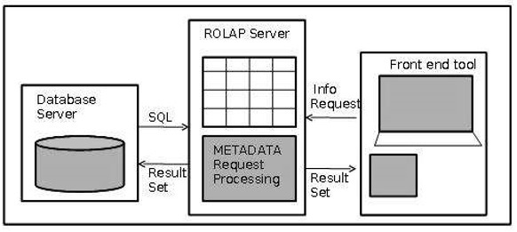
56
Relational OLAP(ROLAP)
ROLAP servers can be easily used with existing RDBMS.
Data can be stored efficiently, since no zero facts can be stored.
ROLAP tools do not use pre-calculated data cubes.
Department of Computer Engineering, VIIT , Pune-48

Slide 57
57
Multidimensional OLAP (MOLAP)
Multidimensional OLAP (MOLAP) uses the array-based multidimensional storage engines for multidimensional views of data.
With multidimensional data stores, the storage utilization may be low if the data set is sparse.
Therefore many MOLAP Server uses the two level of data storage representation to handle dense and sparse data sets.
Advantages
MOLAP allows fastest indexing to the pre-computed summarized data.
Helps the users connected to a network who need to analyze larger, less-defined data.
Easier to use, therefore MOLAP is suitable for inexperienced users.
Disadvantages
MOLAP are not capable of containing detailed data.
The storage utilization may be low if the data set is sparse.

Slide 58
58
MOLAP tools use specialized data structures and multi-dimensional database management systems (MDDBMS) to organize, navigate, and analyze data.
MOLAP data structures use array technology and efficient storage techniques that minimize the disk space requirements through sparse data management.
The development issues associated with MOLAP:
Only a limited amount of data can be efficiently stored and analyzed.
Navigation and analysis of data are limited because the data is designed according to previously determined requirements.
MOLAP products require a different set of skills and tools to build and maintain the database.
Department of Computer Engineering, VIIT , Pune-48

Slide 59

59
MOLAP tools process information with consistent response time regardless of level of summarizing or calculations selected.
MOLAP tools need to avoid many of the complexities of creating a relational database to store data for analysis.
MOLAP tools need fastest possible performance.
MOLAP server adopts two level of storage representation to handle dense and sparse data sets.
Denser sub-cubes are identified and stored as array structure.
Sparse sub-cubes employ compression technology.
Department of Computer Engineering, VIIT , Pune-48

Slide 60
60
Hybrid OLAP (HOLAP)
The hybrid OLAP technique combination of ROLAP and MOLAP both.
It has both the higher scalability of ROLAP and faster computation of MOLAP.
HOLAP server allows to store the large data volumes of detail data.
HOLAP tools deliver selected data directly from DBMS or via MOLAP server to the desktop (or local server) in the form of data cube, where it is stored, analyzed, and maintained locally is the fastest-growing type of OLAP tools.
Department of Computer Engineering, VIIT , Pune-48

Slide 61
61
With this use of the two OLAPs, the data is stored in both multidimensional databases and relational databases. The decision to access one of the databases depends on which is most appropriate for the requested processing application or type.
https://www.sisense.com/glossary/olap/
Department of Computer Engineering, VIIT , Pune-48

Slide 62
62
Like MOLAP, HOLAP causes the aggregations of the partition to be stored in a multidimensional structure in an SQL Server Analysis Services instance.
HOLAP does not cause a copy of the source data to be stored.
For queries that access only summary data in the aggregations of a partition, HOLAP is the equivalent of MOLAP.
Department of Computer Engineering, VIIT , Pune-48

Slide 63
63
Specialized SQL Servers
specialized SQL servers provides advanced query language and query processing support for SQL queries over star and snowflake schemas in a read-only environment.
Department of Computer Engineering, VIIT , Pune-48

Slide 64
64
OLAP Operations
Roll-Up
Drill-Down
Slice & Dice
Pivot
Drill-Across
Drill-Through
Department of Computer Engineering, VIIT , Pune-48

Slide 65
65
Roll-Up Operation
This operation performs aggregation on a data cube in any of the following way:
By climbing up a concept hierarchy for a dimension
By dimension reduction.
The roll-up operation is performed by climbing up a concept hierarchy for the dimension location.
Initially the concept hierarchy was “street < city < state < country”.
On rolling up the data is aggregated by ascending the location hierarchy from the level of city to level of country.
The data is grouped into cities rather than countries.
When roll-up operation is performed then one or more dimensions from the data cube are removed.
Consider the diagram showing the roll-up operation
Department of Computer Engineering, VIIT , Pune-48

Slide 66
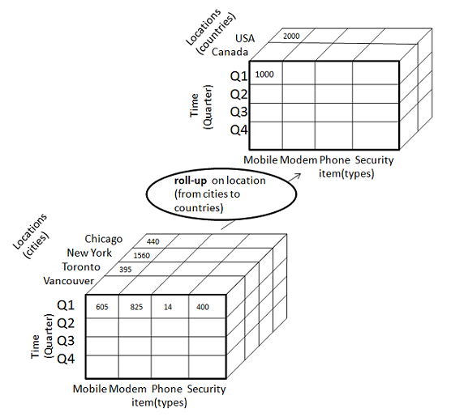
Department of Computer Engineering, VIIT , Pune-48

Slide 67
67
When roll-up is performed by dimension reduction, one or more dimensions are removed from the given cube.
For example, consider the sale data cube containing only two dimensions like location and time.
Roll-up may be performed by removing the time dimension, resulting in an aggregation of the total sales by location, rather than by location and by time.
Department of Computer Engineering, VIIT , Pune-48

Slide 68
68
Drill-down
Drill-down operation is reverse of the roll-up. This operation is performed by either of the following way:
By stepping down a concept hierarchy for a dimension.
By introducing new dimension.
The drill-down operation is performed by stepping down a concept hierarchy for the dimension time.
Initially the concept hierarchy was "day < month < quarter < year.”
On drill-up the time dimension is descended from the level quarter to the level of month.
When drill-down operation is performed then one or more dimensions from the data cube are added.
It navigates the data from less detailed data to highly detailed data.
Consider the diagram showing the drill-down operation:
Department of Computer Engineering, VIIT , Pune-48

Slide 69
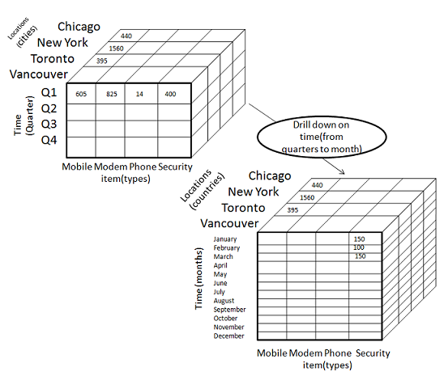
69
Drill-down
Department of Computer Engineering, VIIT , Pune-48

Slide 70
70
The resulting data cube details the total sales per month rather than summarizing them by quarter.
Because a drill down adds more detail to the given data, it can also be performed by adding new dimensions to a cube.
Department of Computer Engineering, VIIT , Pune-48

Slide 71
71
Slice Operation
The slice operation performs selection of one dimension on a given cube and give us a new sub cube.
The Slice operation is performed for the dimension time using the criterion time ="Q1".
It will form a new sub cube by selecting one or more dimensions.
Consider the diagram showing the slice operation.
Department of Computer Engineering, VIIT , Pune-48

Slide 72
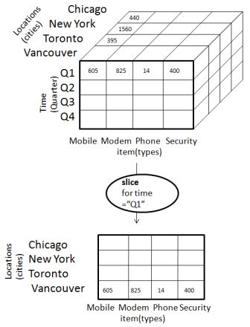
Department of Computer Engineering, VIIT , Pune-48

Slide 73
73
Dice Operation
The Dice operation performs selection of two or more dimension on a given cube and give us a new subcube.
The dice operation on the cube based on the following selection criteria that involve three dimensions.
(location = "Toronto" or "Vancouver“)
(time = "Q1" or "Q2“)
(item =" Mobile" or "Modem").
Department of Computer Engineering, VIIT , Pune-48

Slide 74
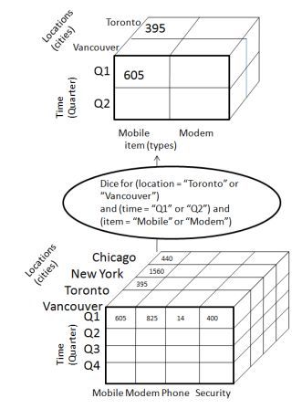
Department of Computer Engineering, VIIT , Pune-48

Slide 75
75
Pivot Operation
The pivot operation is also known as rotation.
It rotates the data axes in view in order to provide an alternative presentation of data.
Consider the diagram showing the pivot operation.
Department of Computer Engineering, VIIT , Pune-48

Slide 76
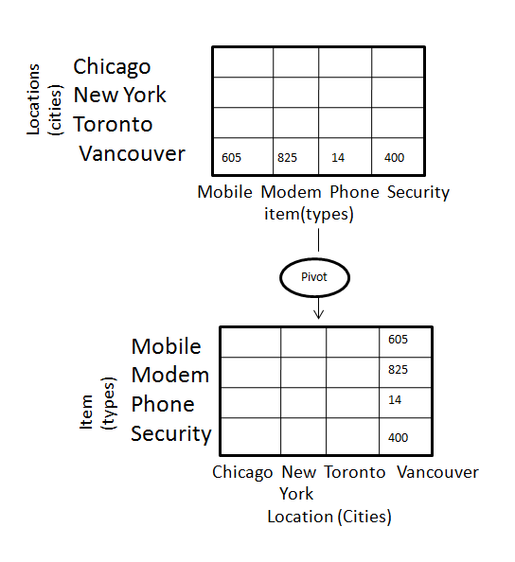
Department of Computer Engineering, VIIT , Pune-48

Slide 77
77
Other OLAP Operations
Drill-Across: Queries involving more than one fact table.
Drill-Through: Makes use of SQL to drill through the bottom level of a data cube down to its back-end relational tables.
Pivot (rotate): Pivot (also called "rotate") is a visualization operation which rotates the data axes in view in order to provide an alternative presentation of the data.
Department of Computer Engineering, VIIT , Pune-48

Slide 78
78
Data Warehouse vs. Operational DBMS
OLTP (on-line transaction processing)
Major task of traditional relational DBMS
Day-to-day operations: purchasing, inventory, banking, manufacturing, registration, accounting, etc.
OLAP (on-line analytical processing)
Major task of data warehouse system
Data analysis and decision making
Department of Computer Engineering, VIIT , Pune-48

Slide 79
79
User and system orientation: customer vs. market:
An OLTP is custom-oriented and is used for transaction and query processing by clerks, clients and information technology.
An OLAP is market oriented and is used for data analysis by knowledge workers, including managers,executive and analysis.
Data contents:
An OLTP manages current data that are too detailed and can be easily used for decision making.
An OLAP system manages large amount of historical data,provide facilities for summarization.
Database design
An OLTP uses ER-model and application oriented database design and an OLAP uses subject oriented database system.
View
An OLTP focuses on current data while OLAP focuses on historical data.
Department of Computer Engineering, VIIT , Pune-48

Slide 80
80
Parameters | OLTP | OLAP
Characteristics | Operational processing | Informational processing
Orientation | Transaction | Analysis
users | clerk, IT & database professional | knowledge worker(manager)
function | day to day operations | decision support
DB design | application-oriented, ER-based | subject-oriented(star, snowflake)
data | current, up-to-date detailed, | historical, summarized, multidimensional
access | read/write index/hash on primary key | lots of scans, mostly read
unit of work | short, simple transaction | complex query
No.of users | thousands | Hundreds
DB size | 100 MB to GB | 100 GB to TB
Department of Computer Engineering, VIIT , Pune-48

Slide 81
Parameters | OLTP | OLAP
Characteristic | It is characterized by large numbers of short online transactions. | It is characterized by a large volume of data.
Functionality | OLTP is an online database modifying system. | OLAP is an online database query management system.
Method | OLTP uses traditional DBMS. | OLAP uses the data warehouse.
Query | Insert, Update, and Delete information from the database. | Mostly select operations
Table | Tables in OLTP database are normalized. | Tables in OLAP database are not normalized.
Source | OLTP and its transactions are the sources of data. | Different OLTP databases become the source of data for OLAP.
Data Integrity | OLTP database must maintain data integrity constraint. | OLAP database does not get frequently modified. Hence, data integrity is not an issue.
Response time | It's response time is in millisecond. | Response time in seconds to minutes.

Slide 82
Parameters | OLTP | OLAP
Usefulness | It helps to control and run fundamental business tasks. | It helps with planning, problem-solving, and decision support.
Operation | Allow read/write operations. | Only read and rarely write.
Query Type | Queries in this process are standardized and simple. | Complex queries involving aggregations.
Design | DB design is application oriented. Example: Database design changes with industry like Retail, Airline, Banking, etc. | DB design is subject oriented. Example: Database design changes with subjects like sales, marketing, purchasing, etc.

Slide 83
Parameters | OLTP | OLAP
User type | It is used by Data critical users like clerk, DBA & Data Base professionals. | Used by Data knowledge users like workers, managers, and CEO.
Purpose | Designed for real time business operations. | Designed for analysis of business measures by category and attributes.
Performance metric | Transaction throughput is the performance metric | Query throughput is the performance metric.
Number of users | This kind of Database users allows thousands of users. | This kind of Database allows only hundreds of users.
Productivity | It helps to Increase user's self-service and productivity | Help to Increase productivity of the business analysts.
Data quality | The data in the OLTP database is always detailed and organized. | The data in OLAP process might not be organized.

Slide 84
Parameters | OLTP | OLAP
Challenge | Data Warehouses historically have been a development project which may prove costly to build. | An OLAP cube is not an open SQL server data warehouse. Therefore, technical knowledge and experience is essential to manage the OLAP server.
Process | It provides fast result for daily used data. | It ensures that response to the query is quicker consistently.
Characteristic | It is easy to create and maintain. | It lets the user create a view with the help of a spreadsheet.
Style | OLTP is designed to have fast response time, low data redundancy and is normalized. | A data warehouse is created uniquely so that it can integrate different data sources for building a consolidated database

Slide 85
85
Big Data Lakes
A data lake is a storage repository that holds a vast amount of raw data in its native format until it is needed.
While a hierarchical data warehouse stores data in files or folders, a data lake uses a flat architecture to store data.
Department of Computer Engineering, VIIT , Pune-48

Slide 86
86
Big Data Lakes
During the development of a data warehouse, a considerable amount of time is spent analyzing data sources, understanding business processes and profiling data. The result is a highly structured data model designed for reporting.
A large part of this process includes making decisions about what data to include and to not include in the warehouse. Generally, if data isn’t used to answer specific questions or in a defined report, it may be excluded from the warehouse.
Department of Computer Engineering, VIIT , Pune-48

Slide 87
87
Big Data Lakes
This is usually done to simplify the data model and also to conserve space on expensive disk storage that is used to make the data warehouse performant.
In contrast, the data lake retains ALL data. Not just data that is in use today but data that may be used and even data that may never be used just because it MIGHT be used someday. Data is also kept for all time so that we can go back in time to any point to do analysis.
Department of Computer Engineering, VIIT , Pune-48

Slide 88
88
Big Data Lakes
What is Data Lake?
A Data Lake is a storage repository that can store large amount of structured, semi-structured, and unstructured data. It is a place to store every type of data in its native format with no fixed limits on account size or file.
It offers high data quantity to increase analytic performance and native integration.
Data Lake is like a large container which is very similar to real lake and rivers. Just like in a lake you have multiple tributaries coming in, a data lake has structured data, unstructured data, machine to machine, logs flowing through in real-time.
Department of Computer Engineering, VIIT , Pune-48

Slide 89
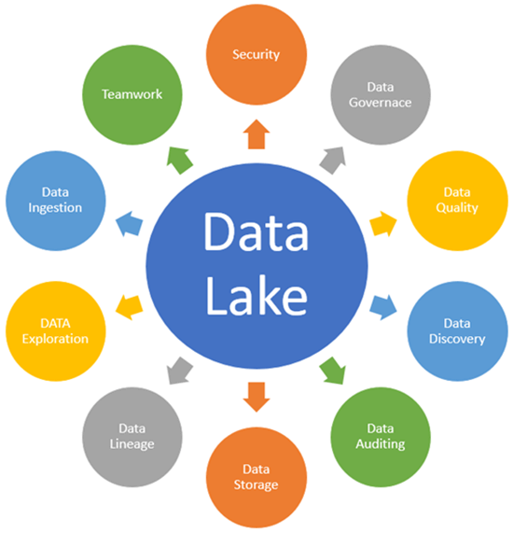
89
Big Data Lakes
Department of Computer Engineering, VIIT , Pune-48

Slide 90
90
Big Data Lakes
Key points of Data Lake
Data Ingestion
Data Ingestion allows connectors to get data from a different data sources and load into the Data lake.
Data Ingestion supports: All types of Structured, Semi-Structured, and Unstructured data.
Multiple ingestions like Batch, Real-Time, One-time load.
Many types of data sources like Databases, Webservers, Emails, IoT etc.
Data Storage
Data storage should be scalable, offers cost-effective storage and allow fast access to data exploration. It should support various data formats.
Data Governance
Data governance is a process of managing availability, usability, security, and integrity of data used in an organization.
Department of Computer Engineering, VIIT , Pune-48

Slide 91
91
Big Data Lakes
Security
Security needs to be implemented in every layer of the Data lake. It starts with Storage, Detection, and Consumption. The basic need is to stop access for unauthorized users. It should support different tools to access data with easy to navigate GUI and Dashboards.
Authentication, Accounting, Authorization and Data Protection are some important features of data lake security.
Data Quality:
Data quality is an essential component of Data Lake architecture. Data is used to extract business value. Extracting insights from poor quality data will lead to poor quality insights.
Data Discovery
Data Discovery is another important stage before you can begin preparing data or analysis. In this stage, tagging technique is used to express the data understanding, by organizing and interpreting the data ingested in the Data lake.
Department of Computer Engineering, VIIT , Pune-48

Slide 92
92
Big Data Lakes
Data Auditing
Two major Data auditing tasks are tracking changes to the key dataset.
Tracking changes to important dataset elements
Captures how/ when/ and who changes to these elements.
Data auditing helps to evaluate risk and compliance.
Data Lineage
This component deals with data's origins. It mainly deals with where it movers over time and what happens to it. It eases errors corrections in a data analytics process from origin to destination.
Data Exploration
It is the beginning stage of data analysis. It helps to identify right dataset is vital before starting Data Exploration.
All given components need to work together to play an important part in Data lake building easily evolve and explore the environment.
Department of Computer Engineering, VIIT , Pune-48

Slide 93
93
Big Data Lakes
Reasons for using Data Lake are:
With the increase in data volume, data quality, and metadata, the quality of analyses also increases.
Data Lake offers business Agility
Machine Learning and Artificial Intelligence can be used to make profitable predictions.
It offers a competitive advantage to the implementing organization.
Department of Computer Engineering, VIIT , Pune-48

Slide 94
94
Big Data Lakes
Characteristics | Data Warehouse | Data Lake
Data | Relational from transactional systems, operational databases, and line of business applications | Non-relational and relational from IoT devices, web sites, mobile apps, social media, and corporate applications
Schema | Designed prior to the DW implementation (schema-on-write) | Written at the time of analysis (schema-on-read)
Price/Performance | Fastest query results using higher cost storage | Query results getting faster using low-cost storage
Department of Computer Engineering, VIIT , Pune-48

Slide 95
95
Big Data Lakes
Characteristics | Data Warehouse | Data Lake
Data Quality | Highly curated data that serves as the central version of the truth | Any data that may or may not be curated (ie. raw data)
Users | Business analysts | Data scientists, Data developers, and Business analysts (using curated data)
Analytics | Batch reporting, BI and visualizations | Machine Learning, Predictive analytics, data discovery and profiling
Department of Computer Engineering, VIIT , Pune-48

Slide 96
96
Big Data Lakes
Parameters | Data Lakes | Data Warehouse
Data | Data lakes store everything. | Data Warehouse focuses only on Business Processes.
Processing | Data are mainly unprocessed | Highly processed data.
Type of Data | It can be Unstructured, semi-structured and structured. | It is mostly in tabular form & structure.
Task | Share data stewardship | Optimized for data retrieval
Agility | Highly agile, configure and reconfigure as needed. | Compare to Data lake it is less agile and has fixed configuration.
Users | Data Lake is mostly used by Data Scientist | Business professionals widely use data Warehouse
Storage | Data lakes design for low-cost storage. | Expensive storage that give fast response times are used
Department of Computer Engineering, VIIT , Pune-48

Slide 97
97
Big Data Lakes
Parameters | Data Lakes | Data Warehouse
Security | Offers lesser control. | Allows better control of the data.
Schema | Schema on reading (no predefined schemas) | Schema on write (predefined schemas)
Data Processing | Helps for fast ingestion of new data. | Time-consuming to introduce new content.
Data Granularity | Data at a low level of detail or granularity. | Data at the summary or aggregated level of detail.
Tools | Can use open source/tools like Hadoop/ Map Reduce | Mostly commercial tools.
Department of Computer Engineering, VIIT , Pune-48

Slide 98
98
Big Data Lakes
Summary:
A Data Lake is a storage repository that can store large amount of structured, semi-structured, and unstructured data.
The main objective of building a data lake is to offer an unrefined view of data to data scientists.
Data Ingestion, Data storage, Data quality, Data Auditing, Data exploration, Data discover are some important components of Data Lake Architecture
Design of Data Lake should be driven by what is available instead of what is required.
Data Lake reduces long-term cost of ownership and allows economic storage of files
The biggest risk of data lakes is security and access control. Sometimes data can be placed into a lake without any oversight, as some of the data may have privacy and regulatory need.
Department of Computer Engineering, VIIT , Pune-48

Slide 99
99
Case Study: Data Lakes
Amazon Simple Storage Service (S3) is the largest and most performant object storage service for structured and unstructured data and the storage service of choice to build a data lake. With Amazon S3, you can cost-effectively build and scale a data lake of any size in a secure environment where data is protected by 99.999999999% of durability.
With a data lake built on Amazon S3, you can use native AWS services to run big data analytics, artificial intelligence (AI), machine learning (ML), high-performance computing (HPC) and media data processing applications to gain insights from your unstructured data sets.
Department of Computer Engineering, VIIT , Pune-48

Slide 100
100
You also have the flexibility to use your preferred analytics, AI, ML, and HPC applications from the Amazon Partner Network (APN). Because Amazon S3 supports a wide range of features, IT managers, storage administrators, and data scientists are empowered to enforce access policies, manage objects at scale and audit activities across their S3 data lakes.
Amazon S3 hosts more than 10,000 data lakes.
Department of Computer Engineering, VIIT , Pune-48

Slide 101
101
References
https://aws.amazon.com/big-data/datalakes-and-analytics/what-is-a-data-lake/
https://www.guru99.com/data-lake-architecture.html
https://aws.amazon.com/products/storage/data-lake-storage/
Department of Computer Engineering, VIIT , Pune-48

Slide 102
102
Thank You
Department of Computer Engineering, VIIT , Pune-48

